Slide 1
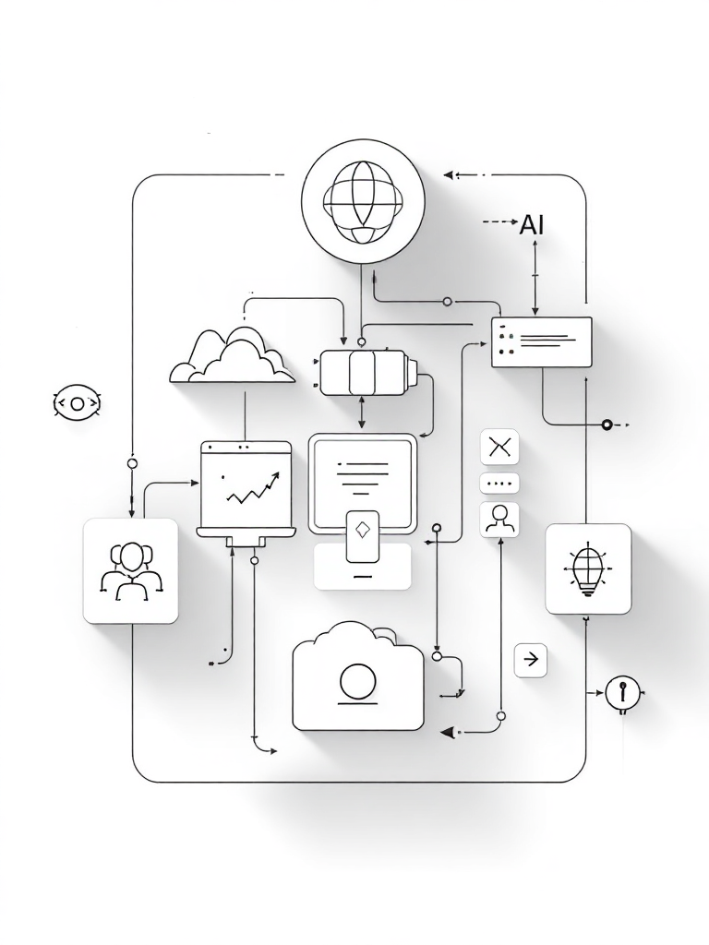
AI-Integrated Multi-Modal Academic Evaluation, Performance Intelligence, and Automated Viva Assessment System
R26-SE-025

Slide 3
AI-Integrated Multi-Modal Academic Evaluation, Performance Intelligence, and Automated Viva Assessment System
The Problem
increased assessment workload
Manual grading of exams is time-consuming and inconsistent.
Human factors such as examiner fatigue and cognitive load.
Users & Stakeholders
Primary Users: Lecturers, examiners
Institutional Stakeholders: Universities, examination boards,
Impact on Users & Society
Delayed feedback affects student learning improvement.
Inconsistent grading reduces trust in academic evaluation fairness.
High operational costs due to heavy manual marking.
R26-SE-025

Slide 4
AI-Integrated Multi-Modal Academic Evaluation, Performance Intelligence, and Automated Viva Assessment System
Proposed Solution
Uses LLM techniques (NLP, Computer Vision, Speech Analysis) to evaluate multiple answer formats.
Supports text answers, handwritten scripts, diagrams and viva responses.
Provides consistent, scalable, and explainable automated grading with human supervision.
Overcomes Limitations
Reduces examiner workload.
Improves fairness and consistency using intelligent evaluation models.
Generates performance analytics and learning insights for educators.
R26-SE-025

Slide 5

IT22262554 | Senarathna A.M
Handwritten ER Diagram Extraction and Evaluating Module
Efficient Reliable Diagram Extraction | Evaluation ER Diagrams from Student’s Answer Sheets
Accurately ER diagram Extraction
Understanding and Diagram Evaluation
Considering Alternative Diagram Correctness
Automated Grading & Explanation
IT22262554 | Senarathna A.M | R26-SE-025

Slide 6
Handwritten ER Diagram Extraction and Evaluating Module
Problems
Workload For Educators
Many Enrollments for the CS Programs
Student’s Pressure For the Educators
Evaluating Diagrams Needs More Time
IT22262554 | Senarathna A.M | R26-SE-025

Slide 7
Handwritten ER Diagram Extraction and Evaluating Module
Main Objective
Reliable and Efficient ER Diagram Extracting
Evaluate the Extracted diagram And Grading
Sub Objectives
High recognition accuracy Evaluate the Real Exam Conditions.
Semantic Diagram Comparison
Dynamic Scoring
Error Handling and Noise Robustness
IT22262554 | Senarathna A.M | R26-SE-025

Slide 8
Handwritten ER Diagram Extraction and Evaluating Module
Methodology
Extract Diagrams Photographed Exam Answer Sheets
  YOLO(ultralytics) , Faster R-CNN
Remove Noise & Increase Clarity.
  Image preprocessing (OpenCV)
Recognizes ER diagram components.
  Convolutional Neural Networks (CNNs)
Compares the student ER diagram With Rubrik.
  Large Language Models (HuggingFace)
Assigns marks based on correctness.
IT22262554 | Senarathna A.M | R26-SE-025

Slide 9
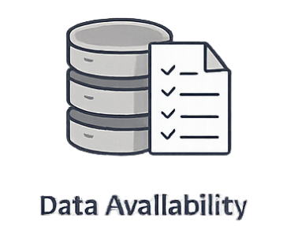
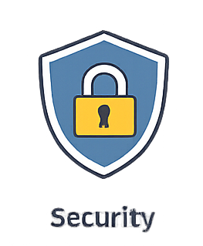
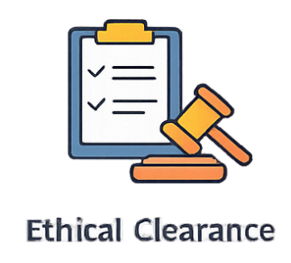
Handwritten ER Diagram Extraction and Evaluating Module
Build a dataset with different handwriting styles & diagram structures.
Include noisy data to test robustness.
Validate & Evaluate
Recognition Accuracy Evaluation
Diagram Extraction Accuracy
Semantic Diagram Comparison Validation
Testing with Real Exam Papers
Comparison with Manual Grading
Answer sheets are anonymized before using them in the dataset.
Data encryption and access control to prevent unauthorized use.
Approval from the university before collecting data.
Use the collected data only for research and system evaluation purposes.
IT22262554 | Senarathna A.M | R26-SE-025

Slide 10
Handwritten ER Diagram Extraction and Evaluating Module
Implementation Details
Data Input Module
  Collect answer sheets containing handwritten ER diagrams.
Preprocessing Module
  Remove background noise, eliminate answer sheet rulers/lines
Diagram Detection
  Detect ER diagram elements such as entities, relationships, attributes, and connectors
Diagram Comparison
  Compare the extracted student diagram evaluate correctness and completeness
Scoring and Feedback
  Generate automated marks and provide feedback based on missing components, incorrect relationship
IT22262554 | Senarathna A.M | R26-SE-025

Slide 11

IT22239198 | Wickramarathne H.I.B
Handwritten Answer Parsing & Evaluation Module
Central AI model Connecting the system | Handwritten text extraction | Grading and Evaluation
Evaluating Physical papers
Explainable AI
Conceptual Reasoning
Diverse Question Formats
IT22239198 | Wickramarathne H.I.B | R26-SE-025

Slide 12
Handwritten Answer Parsing & Evaluation Module
WHY
Manual Limitations | Digital Disconnect | Black-Box Effect
Value
Explainable AI | Physical-Digital Bridge | Conceptual Reasoning
Goal
Unified Framework | Human-AI Alignment | Efficiency
IT22239198 | Wickramarathne H.I.B | R26-SE-025

Slide 13
Handwritten Answer Parsing & Evaluation Module​
​
Domain
Knowledge Areas
Latest Technologies
Methodology
Natural Language Processing (NLP)
Optical Character Recognition (OCR)
Explainable AI (XAI)
Design Science Research (DSR)
Data Collection
Preprocessing
Text Analysis
Concept Based Evaluation
Explainable AI
OCR models
NLP models
Explainable AI frameworks
Data visualization tools
IT22239198 | Wickramarathne H.I.B | R26-SE-025

Slide 14
Handwritten Answer Parsing & Evaluation Module​​
​​
​
Data Availability
​
Validation & Evaluation
Scanned Exam Scripts
Teacher Marking Rubrics
OCR / NLP Training Data
Domain info materials
AI Grades vs Teacher Grades
Accuracy / Precision Metrics
Semantic Similarity Scoring
Concept Coverage Analysis
Security
Ethical Considerations
Student Data Anonymization
Secure Storage
Access Control
AI as Decision Support
Explainable AI Transparency
Bias & Fairness Control
IT22239198 | Wickramarathne H.I.B | R26-SE-025

Slide 15
Handwritten Answer Parsing & Evaluation Module​​
​​
​
Shared System Components
Backend API Layer
Web App
Input Dependencies
Technology Dependencies
User Upload Interface (Web App)
Domain Knowledge Sources
Image Processing Libraries (OpenCV)
OCR Engine
Natural Language Processing Models
AI Evaluation Engine
IT22239198 | Wickramarathne H.I.B | R26-SE-025

Slide 16

IT22134776 | L.S.B Hemarathne
AI-Driven Exam Question Analytics and Prediction Module
This core module leverages artificial intelligence to transform raw educational data into actionable insights for educators and students alike.
Analyzes historical exam questions instead of only final grades.
Combines question analysis with student performance data.
Identifies weak concepts and misunderstood questions.
Uses machine learning to predict future exam topics.
IT22134776 | L.S.B Hemarathne | RE26-SE-025

Slide 17
AI-Driven Exam Question Analytics and Prediction Module
The Challenge We're Addressing
Generic Guidance
Lecturers lack personalized, data-driven insights to identify weak concepts and improve exam preparation guidance.
Untapped Data
Grades are stored, but valuable performance data is wasted.
No Error Analysis
Can't identify which specific questions students commonly fail.
Hidden Gaps
Weak concepts and misunderstood topics remain invisible.
IT22134776 | L.S.B Hemarathne | RE26-SE-025

Slide 18
AI-Driven Exam Question Analytics and Prediction Module
Main Objective
Develop an AI-based system to analyze historical exam questions and student performance data to identify learning gaps and predict exam patterns.
Sub-Objectives
Identify weak concepts based on student performance
Predict possible future exam topics using machine learning
Analyse historical exam questions using NLP techniques
IT22134776 | L.S.B Hemarathne | RE26-SE-025

Slide 19

AI-Driven Exam Question Analytics and Prediction Module
Research Methodology
The proposed system applies knowledge from Artificial Intelligence in Education, Educational Data Mining, and Natural Language Processing to analyze historical exam questions and student performance data.
Latest Technologies Used
Natural Language Processing (NLP) – analyse exam question text
Topic Modelling (LDA) – identify exam topic patterns
Machine Learning Models – predict future exam topics
Clustering Algorithms – group similar questions and concepts
IT22134776 | L.S.B Hemarathne | RE26-SE-025

Slide 20
AI-Driven Exam Question Analytics and Prediction Module
1
2
3
1. Validation and Evaluation of the Solution
2. Data Availability
3. Security and Ethical Considerations
Evaluate prediction accuracy using Precision, Recall, and F1-score
Compare predicted exam topics with actual past exam patterns
Test system insights with educator feedback
Historical exam papers
Publicly available online datasets
Anonymization of student data
Secure data storage and controlled access
Compliance with institutional ethical guidelines for educational data
IT22134776 | L.S.B Hemarathne | RE26-SE-025

Slide 21
AI-Driven Exam Question Analytics and Prediction Module
System Overview of the Individual Component
IT22134776 | L.S.B Hemarathne | RE26-SE-025

Slide 22
AI-Driven Exam Question Analytics and Prediction Module
Key Dependencies and Components
Dependencies
Common Components
Python & Libraries
Data Processing Module
Leverages robust Machine Learning and Natural Language Processing libraries for advanced data manipulation.
Responsible for preprocessing and validating exam questions and raw performance data.
Analytical Frameworks
Analytics Engine
Utilizes Scikit-learn and specialized NLP frameworks for in-depth data analysis and pattern recognition.
Performs complex topic modeling and clustering to extract meaningful insights from data.
Secure Database
Prediction Module
Dedicated database for the secure storage of exam data, questions, and performance results.
Employs advanced algorithms to forecast exam patterns and identify individual learning gaps.
IT22134776 | L.S.B Hemarathne | RE26-SE-025

Slide 23

IT22557056 | HERATH B.K.H.M.B.L
AI-Integrated Multi-Modal Viva Evaluation System
AI-Based Multimodal Viva Analysis | Confidence & Performance Evaluation
Video Processing & Facial Expression Analysis
Audio Processing & Voice Pattern Analysis
Audio – Video Engagement Tracking
Automated Confidence Scoring
Multimodal Fusion & Explainable Ai
IT22557056 | Herath B.K.H.M.B.L | R26-SE-025

Slide 24
AI-Integrated Multi-Modal Viva Evaluating Module
Problems and Evaluation
Visual Emotion Detection Accuracy
Subjective Evaluation by Examiners (inconsistent and biased assessment results. )
Limited feedback time (not provide detailed feedback on engagement behavior )
Difficulty in Observing Behavioral Signals & non-verbal
Lack of objective confidence and engagement measurement
Memory limitation and cognitive load
Resource Utilization
Percentage of correctly identified emotional states from facial expressions.
Oral Emotion Recognition Accuracy
Correct classification rate of vocal emotion indicators.
Semantic Answer Similarity Score
Vector similarity between expected and actual answer content.
Confidence Prediction Accuracy
Correlation between predicted and human-assigned confidence levels.
IT22557056 | Herath B.K.H.M.B.L | R26-SE-025

Slide 25
AI-Integrated Multi-Modal Viva Evaluating Module
Main objective
An AI-powered multimodal system that analyzes facial expressions, voice patterns, and body gestures to provide objective, confidence assessment for student viva examinations.
Sub objective
Automated confidence Performance Grading System
Generate Automated Confident and Engagement Report
Detect Student Engagement and Attention
IT22557056 | Herath B.K.H.M.B.L | R26-SE-025

Slide 26

AI-Integrated Multi-Modal Viva Evaluating Module
Methodology & Technologies
Audio Analysis
Video Analysis
OpenAI Whisper
Speech Brain/ Wav2Vec2
MediaPipe (face detect)
Ffmpeg (video process)
DeepFace (CNN based-emotion )
NLP
Semantic Analysis relevance
AI Core
(PYTHON)
Speech Processing
Gustures Analysis
OpenPose
Computer Vision
(OpenCV)
(reading the video to preparing frames for deep learning models)
LLM - Llama (feedback & explain) / NLP –RoBErt (understand evaluate transcribed text)
ML - Random Forest | adaBoost ( video, audio, gestures to produce final scores )
IT22557056 | B.K.H.M.B L Herath | RE26-SE-025

Slide 27
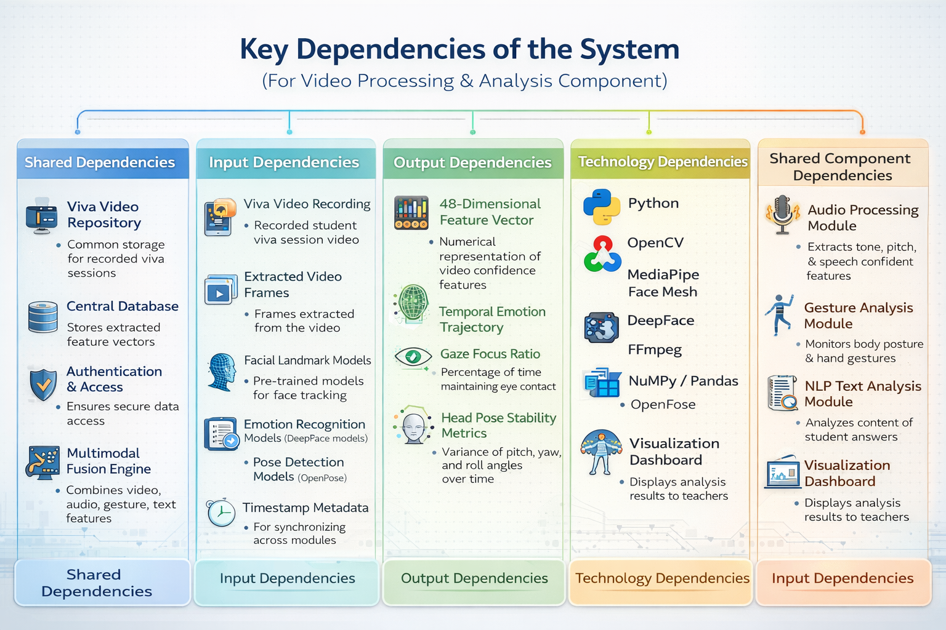
AI-Integrated Multi-Modal Viva Evaluating Module
IT22557056 | Herath B.K.H.M.B.L | R26-SE-025

Slide 28

AI-Integrated Multi-Modal Viva Evaluating Module
2
1
Data Security
Data Availability
Student video and audio recordings stored securely with personal data anonymized.
Sensitive recording will be anonymous.
Only authorized person will access to the data.
Public speech and emotion recognition datasets with sample academic viva recordings. Intern viva also can use for as real data
compared with human examiner evaluations.
Validation Workflow
3
Ethical Clearance
University research ethics committee approval obtained with responsible AI practices followed.
AI system will be used only as a support tool for evaluation, not as a replacement for human examiners.
Student Viva Recording
AI Analysis System
Confidence Score Generated
Compare with Human Evaluation
Calculate Accuracy Metrics
IT22557056 | Herath B.K.H.M.B.L | R26-SE-025

Slide 29

AI-Integrated Multi-Modal Viva Evaluating Module
Research Objectives
Facial Analysis
Facial Expression Analysis
Voice Analysis
Detect emotional engagement and confidence signals from video using computer vision techniques
Speech & NLP
Voice Analysis Module
Multimodal Fusion
Implement pitch, speech rate, pauses, and tone analysis to capture vocal confidence indicators
Reporting
Speech-to-Text
& NLP
Chart illustrates the proposed research emphasis across the five core objective areas, with facial analysis and NLP each receiving the highest focus as the primary signal sources.
Apply transcription and natural language processing to evaluate the relevance and quality of student answers
Body Gestures Analysis
Multimodal Fusion & Reporting
IT22557056 | B.K.H.M.B L Herath | RE26-SE-025

Slide 30
AI-Integrated Multi-Modal Academic Evaluation, Performance Intelligence, and Automated Viva Assessment System
Microservices-Based Product Architecture
  Microservices Architecture for modular deployment
  Each component works as an independent service
Flexible Deployment Model
  Core system can be hosted centrally as a full platform
  Allows quick delivery to different clients
Value Proposition
  Automated academic evaluation reduces educator workload
  AI-powered diagram and answer analysis
Investment / Cost Structure
  Software-as-a-Service (SaaS) subscription model
  Institutional licensing for universities and institutes
  Pay-per-module pricing for individual components
High Availability Deployment
  Multiple replicas for scalability
  Zero downtime deployment
R26-SE-025

Slide 31
AI-Integrated Multi-Modal Academic Evaluation, Performance Intelligence, and Automated Viva Assessment System
Gannt Chart
WBS Chart
R26-SE-025

Slide 32
R26-SE-025

